Slide 1
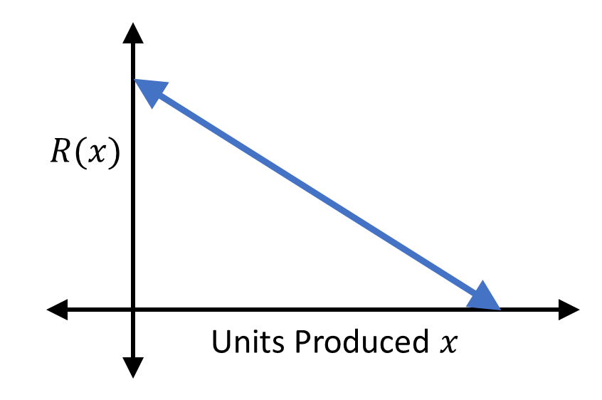

Slide 2


$$R(x)$$
Units Produced $x$

